Slide 1
Introduction

Slide 2
Building Intelligent Machines
The brain is the most incredible organ in the human body.
It enables us to store memories, experience emotions, and even dream.
It dictates the way we per‐ ceive every sight, sound, smell, taste, and touch
The brain is, inher‐ ently, what makes us intelligent.

Slide 3
Human brain
The infant brain only weighs a single pound, but it can solve problems that are difficult for most powerful supercomputers.
Within a matter of months after birth,
infants can recognize the faces of their parents
discern discrete objects from their backgrounds
and even tell apart voices

Slide 4
Human brain cont..
Within a year, they can track objects even when they become partially or completely blocked
can associate sounds with specific mean‐ ings.
And by early childhood, they have a sophisticated understanding of grammar and thousands of words in their vocabularies
For decades, we’ve dreamed of building intelligent machines with brains like ours.

Slide 5
Deep Learning
To tackle the problems that our brains can solve in a manner of microseconds,
we’ll have to develop a radically different way of programming a computer using techniques largely developed over the past decade.
This is an extremely active field of artificial computer intelligence often referred to as deep learning.

Slide 6
The Limits of Traditional Computer Programs
Traditional computer programs are designed to be very good at two things:
1) performing arithmetic really fast
2) explicitly following a list of instructions.
Traditional computer programs are good at heavy financial number crunching

Slide 7
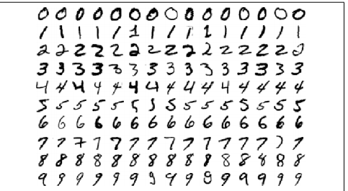
Recognizing hand written digits program
Although every digit in the figure is written in a slightly different way, humans can easily recognize every digit in the first row as a zero, every digit in the second row as a one, etc.
But if want to write a program to automatically read someone’s handwriting, it will be very difficult.

Slide 8

we might state that we have a zero if our image only has a single, closed loop.
but this isn’t really a sufficient condition.
If some one writes a messy zero, it is difficult to distinguish zero and six.
establish some sort of cutoff for the distance between the starting point of the loop and the ending point,
but it’s not exactly clear where we should be drawing the line

Slide 9
The Mechanics of Machine Learning
A lot of the things we learn in school growing up have a lot in common with traditional computer programs.
We learn how to multiply numbers, solve equations, and take derivatives by internalizing a set of instructions.
But the things we learn at an extremely early age, the things we find most natural, are learned by example, not by formula.

Slide 10
We learned to recognize a dog by being shown multiple examples and being corrected when we made the wrong guess.
If our parents said we were wrong, we’d modify our model to incorporate this new information.
Over our lifetime, our model becomes more and more accurate as we assimilate more and more examples

Slide 11
Deep learning is a subset of a more general field of artificial intelligence called machine learning, which is predicated on this idea of learning from example.
In machine learning, instead of teaching a computer a massive list of rules to solve the problem, we give it a model with which it can evaluate examples, and a small set of instructions to modify the model when it makes a mistake.
We expect that, over time, a well-suited model would be able to solve the problem extremely accurately.

